Slide 1
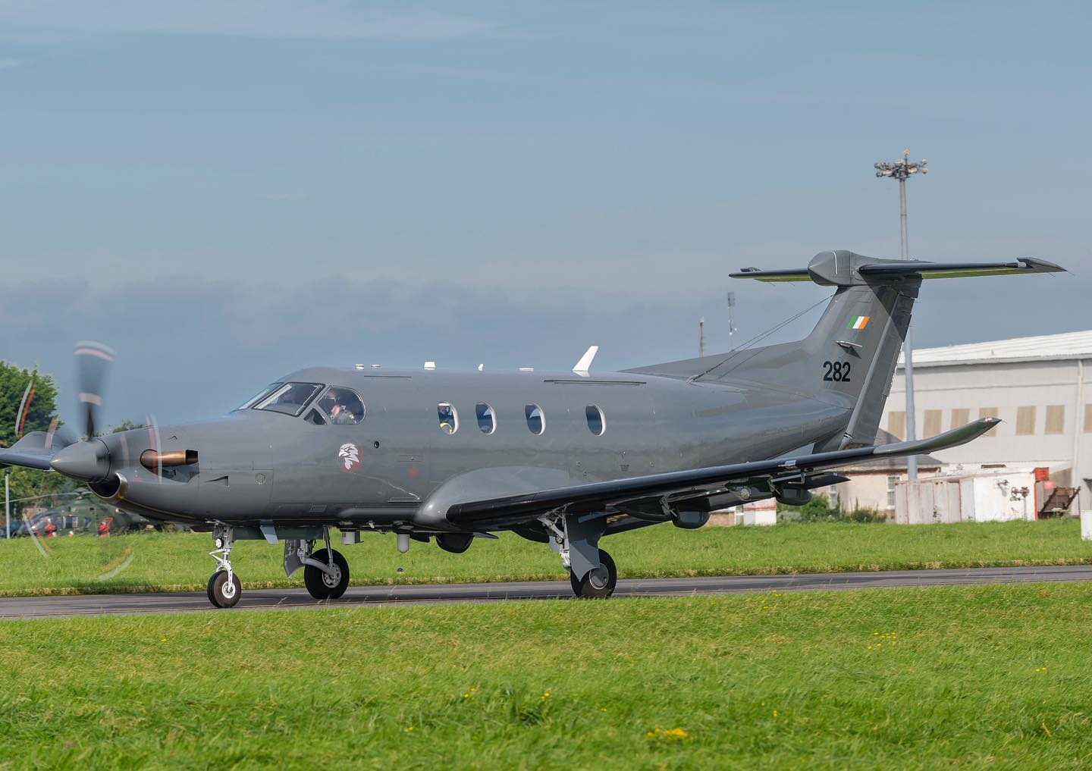
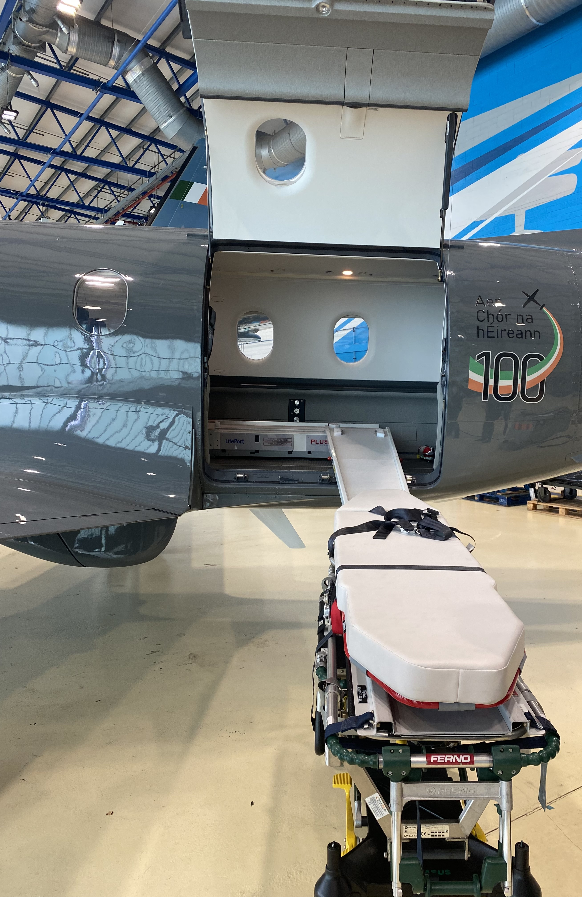
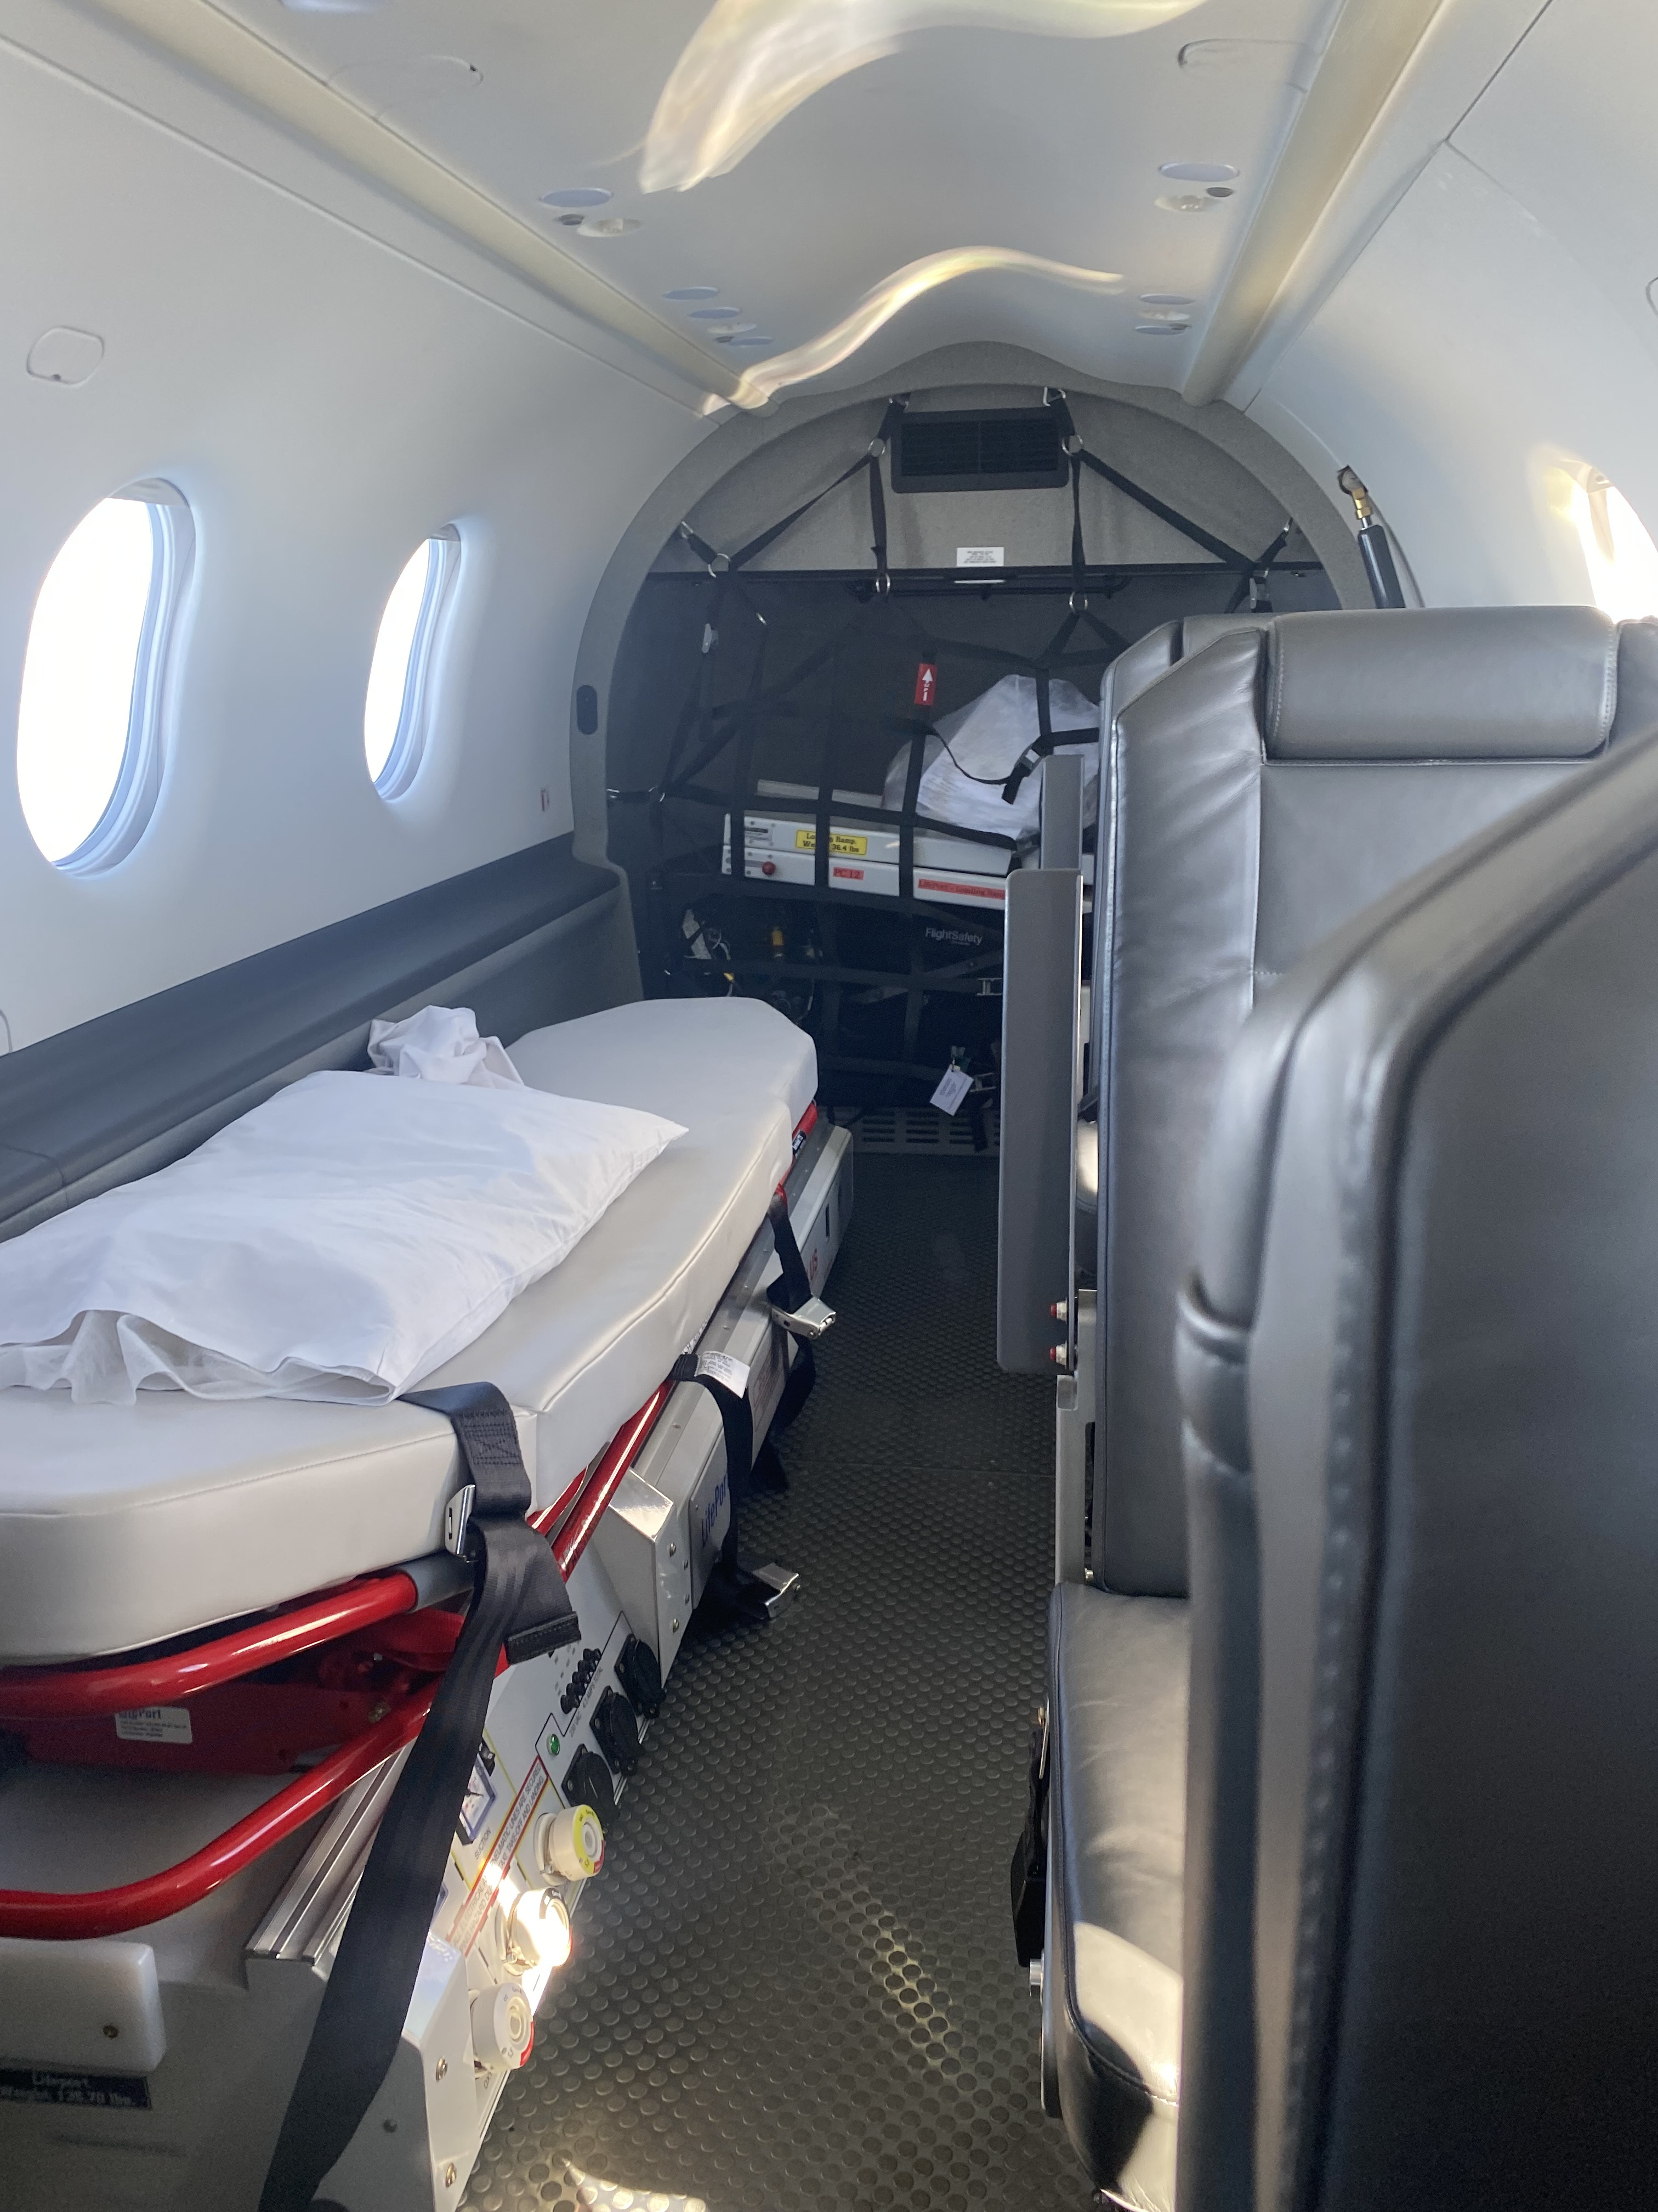
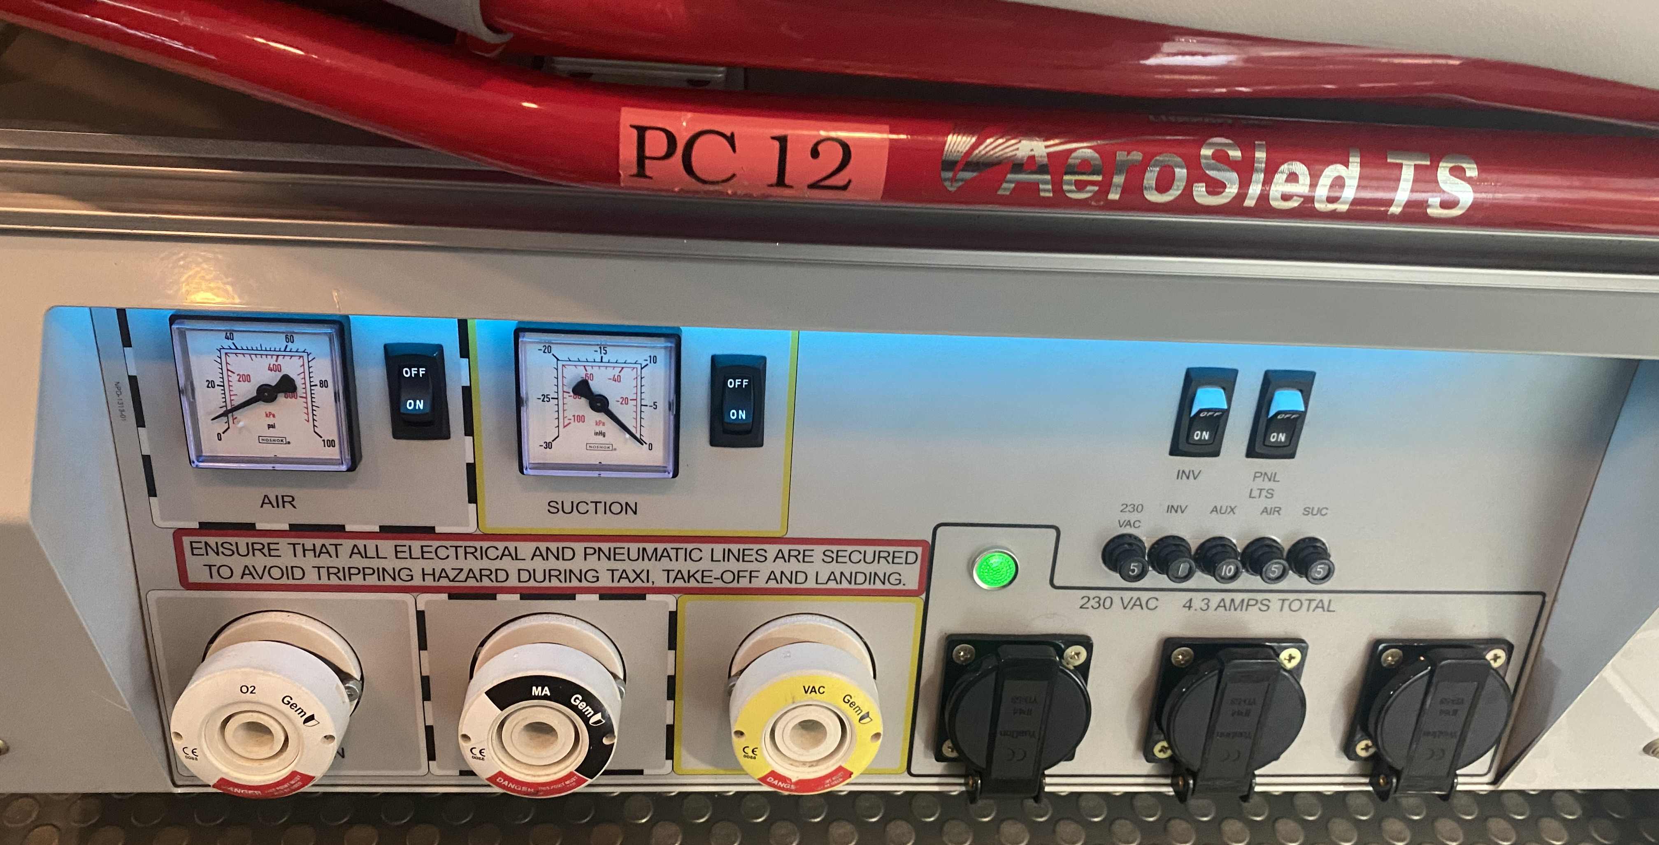
IPATS AIR TRANSPORTS
Fixed Wing – Pilatus PC-12
The Pilatus PC-12 is a fixed wing plane provided by the Irish Air Corp. It is used by IPATS to transfer infants and children overseas. The plane must be reconfigured for air ambulance missions and the life port loaded onto the plane before patient arrival.
Patient transfer is via specialized ramp from a standard Ferno trolley with the aerosled attached via the clip deck.
Patient is loaded headfirst into the craft and lies with their head towards the front of the plane.
Aircraft | PC 12
Standard altitude, cabin pressure and atmospheric P. | Up to 30,000ft. Cabin Pressure 6,500-7,500ft. Atmos P. 80-76 kPa
Standard patient base | Lifeport scan for more info
Patient bed | Aerosled mounted on clip deck
Loading mechanism | Load ramp from centre of plane – patient loaded headfirst
Fitting time for aeromedical use | 1-3 hrs (if aircraft is at base)
Power considerations | Charging is not possible, just battery maintenance
Oxygen supplied | 3000L in ZX cylinder
Suction supplied | No machine, port supplied on lifeport
IPATS engineering equipment needed | Clip deck straps Spare Batteries
Special considerations | Cabin pressure can be increased
Pt. loading
video
Pt. Unloading
video
Alveolar
Gas Calc.
Typical Travel times from Baldonnell Aerodrome
Newcastle Airport | Liverpool Airport | Biggin Hill | Northolt | Manchester Airport | Leeds Airport
60min | 45min | 75min | 75min | 45 min | 60min
Airport to Freeman | Airport to Alder Hey | Airport to kings | Airport to GOSH | Airport to Manchester Children’s | Airport to Leeds Children's
20 minutes | 20 minutes | 45 minutes | 40 minutes | 15 minutes | 20 minutes

Slide 2
IPATS AIR TRANSPORTS
Pre-Departure Checklist
Equipment Checklist
Staff Checklist
Aeromedical Red Bag
Patient specific Airway bag
Spare Massimo + batteries
iSTAT machine/Cartridges
Patient specific Drug/Fridge bag
Zoll monitor + relevant
consumables
Hamilton + Relevant
consumables
Braun Pumps x3 + 1 Infusomat
Appropriate ACRs
Spare battery bag
Additional equipment (as needed)
I.e. USS/CMAC/iNO
Sufficient Oxygen (calc completed)
Portable Suction + consumables
IPATS folder + Documentation
Transwarmer (if temp reg concerns)
All equipment connected and
charging from central power bar
O2 cylinder opened on trolley
O2 hose plugged into ambulance
Passport emailed to NAC
neoc.aeromedical@hse.ie
Mobile phones + charger
Jackets/layers
Food/Fluids
Anti emetics (if required)
Retrieval cash funds
(overseas only)
AnnexF Form sent to neoc.aeromedical@hse.ie
NAC DESK: 1850 211869
Patient Checklist
Working Vascular Access x2 (IV/IO)
All balloon catheters filled with water
Gastric contents emptied
All pneumo- thorax/peritoneum/cephalus risks considered and mitigated where possible
CXR & labs reviewed
Sedation/muscle relaxation considered
Relevant scheduled medications given
Pt specific emergency medications drawn up
Age appropriate ear protection available
Sufficient blankets/layers
All pressure areas reviewed
Altitude associated complications identified and discussed with air crew – i.e. risk of desaturation, presence of any air leaks, need for inc. cabin pressure
Communication Checklist
Discharge Summary
PEWS sheet for past 24hrs
Drug Kardex
Recent laboratory results
CD of all relevant images
Numbers for parents/receiving unit/NAC desk
Accepting unit contacted to confirm time/bed
NAC desk contacted to confirm ambulance availability on arrival
Parent/Guardian:
Name: ________________________
Number: ______________________
Parent/Guardian:
Name: ________________________
Number: ______________________
Referring Consultant:
Name: ________________________
Number: ______________________
Referring Ward:
Name: ________________________
Number: ______________________
Receiving Consultant:
Name: ________________________
Number: ______________________
Receiving Ward:
Name: _________________________
Number: _______________________

